Slide 1


TY Coding
Lesson 05 - Algorithms and Pseudocode

Slide 2


Lesson Objectives
Understand what an algorithm is and its application in programming.
Learn and understand the concept of pseudocode.
Develop the ability to write simple algorithms.
Learn how to translate algorithms into pseudocode.
Understand the importance of efficient algorithm design.

Slide 3

What is an Algorithm?
An algorithm, in relation to computers, is a defined set of step-by-step procedures or instructions that tells a computer exactly what to do to solve a specific problem or complete a particular task.
List the steps needed to create a breakfast of Buttered Toast with Strawberry Jam
Give some examples of how Algorithms are used in Computing
Notes:
Examples of Algorithms include the Algorithm Social Media use to deliver content to you. Car Insurance, Credit Rating etc.

Slide 4
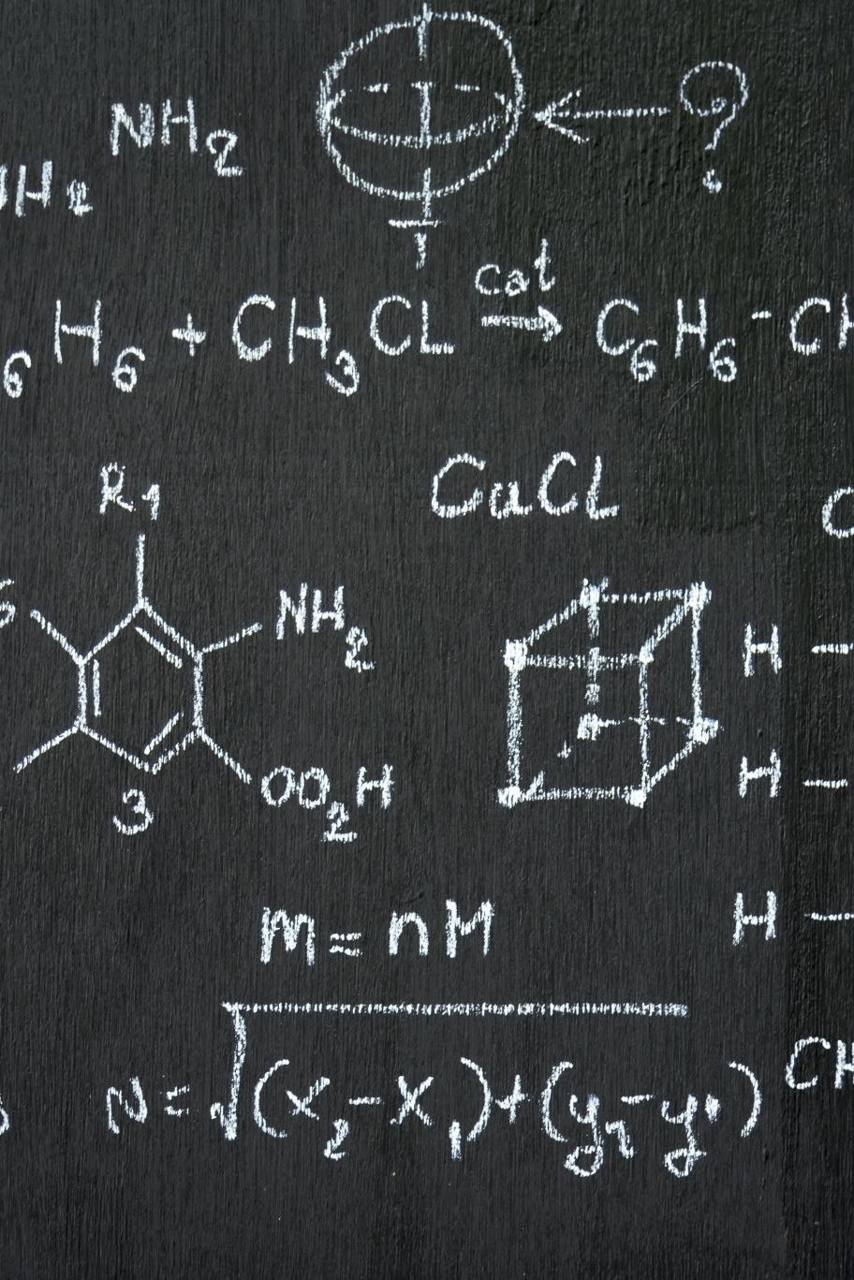
What is Pseudocode?
Pseudocode is a simple way of writing programming code in English or in a way that can be understood by humans. It’s not an actual programming language
Example
1. Start
2. Input num1, num2, num3
3. Set sum = num1 + num2 + num3
4. Set average = sum / 3
5. Output average 6. End

Slide 5
Details of an Algroithim
Steps to Create and Algorithm
Clearly Define the Problem
Identify the Procedures
Order procedures
Check the Procedures
Test the Algorithm
Types of Algorithm
Recursive Algorithms:
Divide and Conquer Algorithms:
Greedy Algorithms:
Randomized Algorithms:
Backtracking Algorithms:
Notes:
Steps to Create and Algorithm
Clearly Define the Problem: Understand what the problem is asking and identify the inputs and outputs.
Identify the Procedures: Identify all the steps needed to solve the problem.
Order procedures: Arrange the steps in a logical sequence while considering any dependencies between the steps.
Check the Procedures: Review the steps to ensure they are detailed enough and can handle any anticipated issues.
Test the Algorithm: Run the algorithm with a set of test data to make sure it solves the problem correctly.
Types of Algorithim
Recursive Algorithms: These algorithms solve problems by calling themselves to solve smaller instances of the same problem.
Divide and Conquer Algorithms: These algorithms work by breaking a problem into smaller sub-problems until they become simple enough to be solved directly.
Greedy Algorithms: These algorithms make the best choice at each step in the hope that these local optimizations will lead to a global optimum.
Randomized Algorithms: These algorithms make random choices during the problem-solving process to provide a variety of possible solutions.
Backtracking Algorithms: These algorithms try out all possible solutions and retract (or backtrack) as soon as they find that the solution cannot be found.

Slide 6
Features of a Good Algorithm
Unambiguous
Well-defined Inputs and Outputs
Finiteness
Feasibility
Language Independent
Independent of Machine
Efficient
Notes:
Unambiguous: Each step in an algorithm should be clear and lead to only one meaning.
Well-defined Inputs and Outputs: An algorithm should have defined inputs & outputs, and it should be clearly stated what each input represents and what is expected from the outputs.
Finiteness: The algorithm must always terminate after a finite time.
Feasibility: An algorithm must be simple, generic and practical such that it can be executed with the available resources.
Language Independent: Algorithms are not written in a programming language, they should be written in such a way that it can be implemented in multiple programming languages.
Independent of Machine: They are machine-independent. They should give the expected output with every type of computer having different configurations.
Efficient: It should make the best use of computational resources (like memory, disk space, time etc).

Slide 7
Purpose and properties of Pseudocode
Clarity
Planning
Communication
Debugging
Simple
Language Independent
Ambiguity Free
High Level
Notes:
Clarity: Pseudocode articulates complex instructions clearly and in a human-friendly format.
Planning: It allows programmers to plan out how they will write their code before they start.
Communication: Pseudocode enables programmers to effectively communicate their algorithmic ideas with colleagues or stakeholders who may not be familiar with programming languages. It provides a common language to discuss and review the proposed solution.
Debugging: Pseudocode helps in spotting logical errors and planning for potential problems before writing the actual code.
Properties
Simple: It uses plain English to describe the steps in an algorithm, which makes it easy to read and understand.
Independent: It’s language independent which means it is not governed by any specific programming language rule. It’s a general outline of the process that the code should follow.
Ambiguity Free: Each instruction is clear and precise.
High Level: It describes the high-level design and logic of the algorithm, without going into the technical details of the programming languages.

Slide 8

Rules of Pseudocode
These are more guidelines
Write one statement per line
Use Simple English
Indent for logic:
Keep it short
Be specific
Notes:
Write one statement per line: Every instruction is clearly defined on a line by itself.
Use Simple English: Avoid any programming language specific jargon, so it’s understandable to people who don’t necessarily know that language.
Indent for logic: Similar to actual code, pseudocode should use indents to identify nested instructions like loops or if else statements.
Keep it short: Focus on the key steps and don’t include unnecessary details that can confuse the reader.
Be specific: While simplicity is key, avoid being vague. Include enough detail to express what is happening in each step clearly.

Slide 9

Creating an Algorithm
START
Fill the kettle with water
Switch on the kettle
While waiting for the water to boil,
Place a tea bag in the cup
Add sugar to the cup (if needed)
When the kettle switches off, pour the hot water into the cup
Stir the tea
Wait for 2 minutes
Remove the tea bag from the cup
If preferred, add milk and stir the tea
The tea is ready for drinking
STOP

Slide 10
Convert to Pseudocode
START
Fill up kettle with water
Turn ON Kettle
Place teabag in cup
IF tea requires sugar THEN
Add sugar in the cup
ENDIF
WAIT until kettle switches OFF
Pour water in cup
Stir the mixture
Wait 2 minutes
Remove teabag
IF milk needed THEN
Add milk to cup
Stir the mixture
ENDIF
PRINT "Tea is ready!"
STOP

